Slide 1
AZ-104T00A Module 06: Network Traffic Management

Slide 2
Module Overview
Lesson 01: Network Routing and Endpoints
Lesson 02: Azure Load Balancer
Lesson 03: Application Gateway
Lesson 04: Traffic Manager
Lesson 05: Module 06 Lab and Review
Notes:
Module overview

Slide 3
Lesson 01: Network Routing and Endpoints

Slide 4
Network Routing Overview
System Routes
User Defined Routes
Routing Example
Create a Routing Table
Create a Custom Route
Associate the Route Table
Demonstration – Custom Routing Tables
Service Endpoints
Service Endpoint Services
Private Link

Slide 5
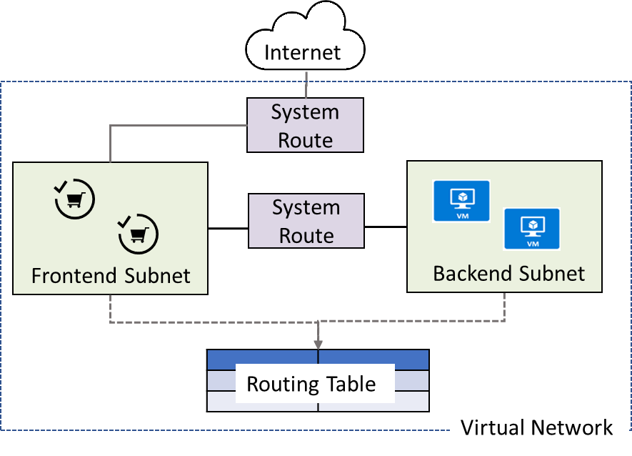
System Routes
System routes direct network traffic between virtual machines, on-premises networks, and the Internet
Traffic between VMs in the same subnet
Between VMs in different subnets in the same virtual network
Data flow from VMs to the Internet
Communication between VMs using a VNet-to-VNet VPN
Site-to-Site and ExpressRoute communication through the VPN gateway
Notes:
System routes - https://docs.microsoft.com/en-us/azure/virtual-network/virtual-networks-udr-overview#system-routes

Slide 6
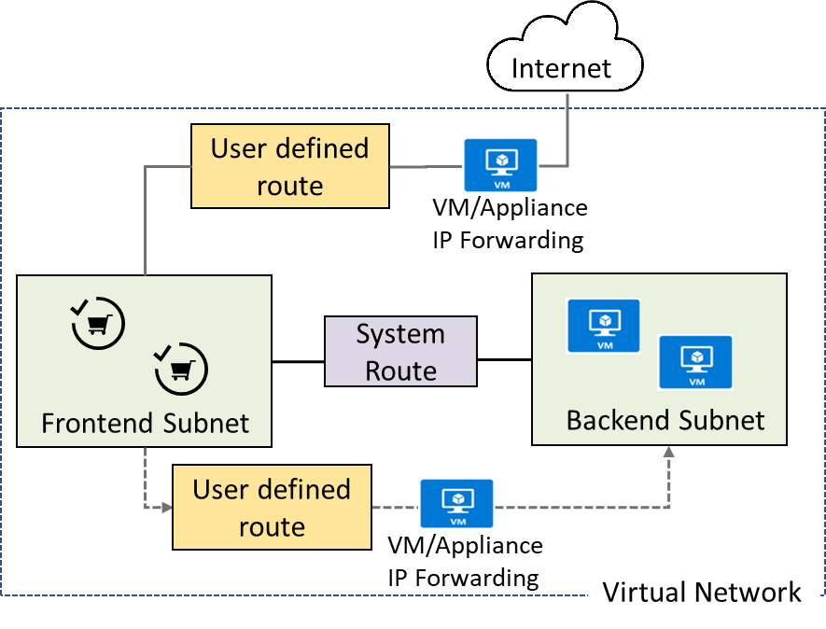
User Defined Routes
A route table contains a set of rules, called routes, that specifies how packets should be routed in a virtual network
User-defined routes are custom routes that control network traffic by defining routes that specify the next hop of the traffic flow
The next hop can be a virtual network gateway, virtual network, internet, or virtual appliance
Notes:
✔ Each route table can be associated to multiple subnets, but a subnet can only be associated to a single route table. There are no additional charges for creating route tables in Microsoft Azure. Do you think you will need to create custom routes?

Slide 7
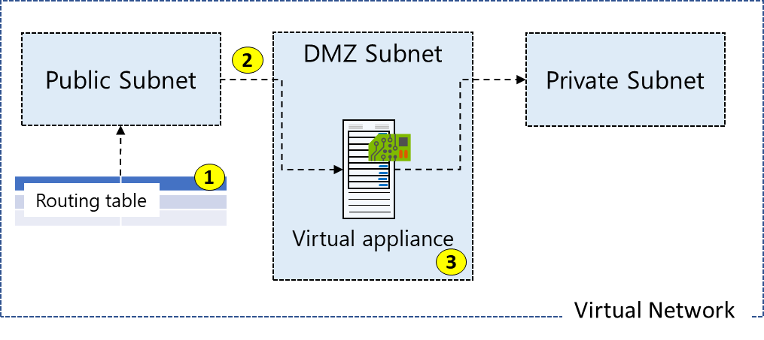
Routing Example
All traffic coming into the public subnet and headed for the private subnet must be go through the virtual network appliance
Create a routing table
Add a custom route that requires all private subnet traffic be directed to a network appliance
Associate the new route to the public subnet
Notes:
The next three topics will cover this information.

Slide 8
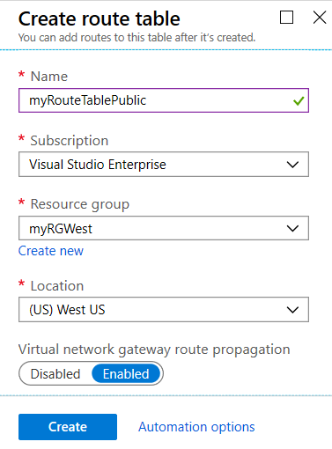
Create a Routing Table
A standard routing protocol is used to exchange routing and reachability information between two or more networks
Routes are automatically added to the route table of all subnets with virtual network gateway route propagation enabled
In most situations you will want to enable route propagation
Notes:
Overview of BGP with Azure VPN Gateways - https://docs.microsoft.com/en-us/azure/vpn-gateway/vpn-gateway-bgp-overview?toc=%2fazure%2fvirtual-network%2ftoc.json

Slide 9
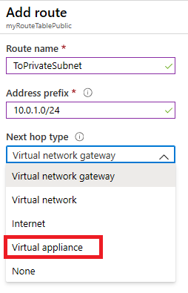
Create a Custom Route
When you create a route there are several Next hop types
In this example, any private subnet IP addresses will be sent to the virtual appliance
Other choices are Virtual network gateway, Virtual network, Internet, and None

Slide 10
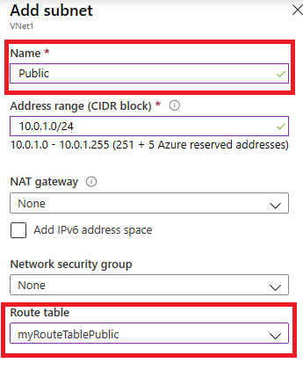
Associate the Route Table
Each subnet can have zero or one route table associated to it
In our example, the Public subnet will be associated with the routing table
Notes:
✔️ In this case the virtual appliance should not have a public IP address and IP forwarding should be enabled.

Slide 11
Demonstration – Custom Routing Tables
Create a route table
Add a route
Associate a route table to a subnet
Use PowerShell to view your routing information
Notes:
✔ Always consider having students walk-through the demonstrations themselves. Also, consider the overlap with the formal labs and your best use of time.

Slide 12
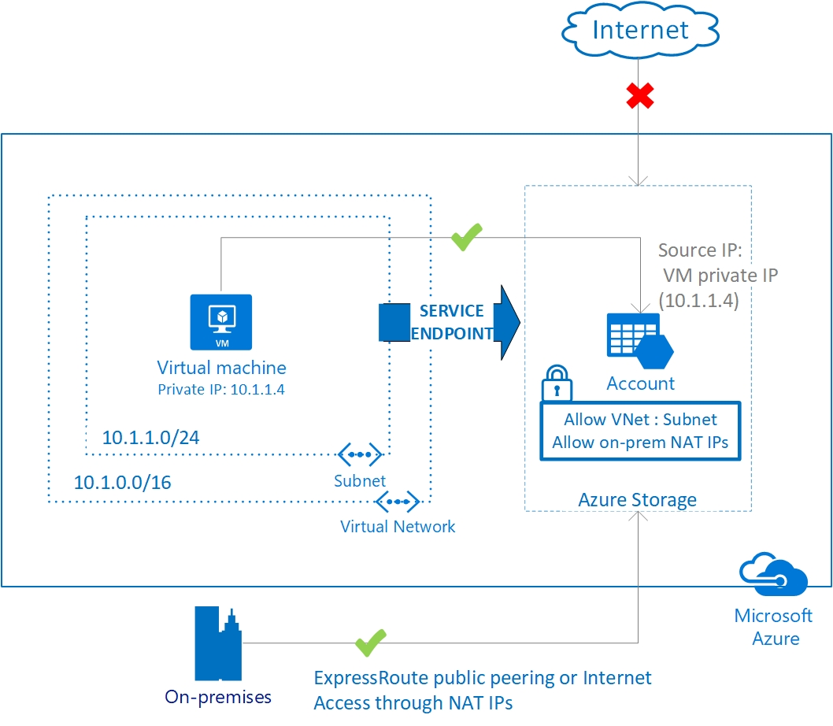
Service Endpoints
Endpoints limit network access to specific subnets and IP addresses
Improved security for your Azure service resources
Optimal routing for Azure service traffic from your virtual network
Endpoints use the Microsoft Azure backbone network
Simple to set up with less management overhead
Notes:
✔️ Can you see a use for service endpoints in your organization?
Virtual network service endpoints - https://docs.microsoft.com/en-us/azure/virtual-network/virtual-network-service-endpoints-overview

Slide 13
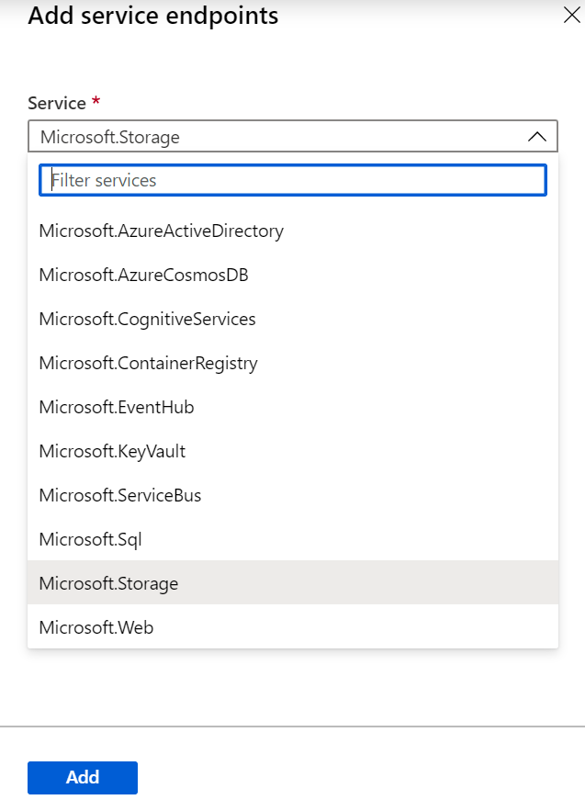
Service Endpoint Services
✔️ Adding service endpoints can take up to 15 minutes to complete

Slide 14
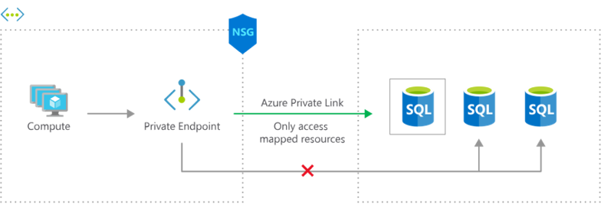
Private Link
Private connectivity to services on Azure. Traffic remains on the Microsoft network, with no public internet access
Integration with on-premises and peered networks
In the event of a security incident within your network, only the mapped resource would be accessible

Slide 15
Lesson 02: Azure Load Balancer

Slide 16
Azure Load Balancer Overview
Azure Load Balancer
Public Load Balancer
Internal Load Balancer
Load Balancer SKUs
Backend Pools
Load Balancer Rules
Session Persistence
Health Probes
Notes:
Lesson overview

Slide 17
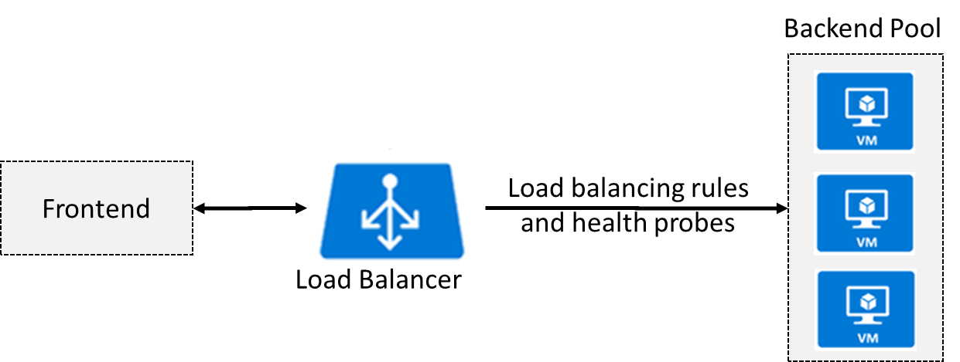
Azure Load Balancer
Distributes inbound traffic to backend resources using load-balancing rules and health probes
Can be used for both inbound/outbound scenarios
Extend Active Directory to the cloud
Two types: Public and Internal
Notes:
✔ Keep this diagram in mind since it covers the four components that must be configured for your load balancer: Frontend IP configuration, Backend pools, Health probes, and Load balancing rules.
Load Balancer documentation - https://docs.microsoft.com/en-us/azure/load-balancer/

Slide 18
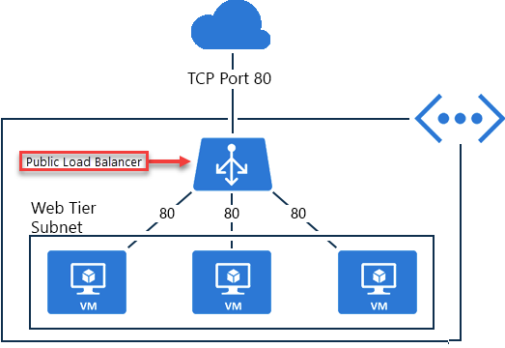
Public Load Balancer
Maps public IP addresses and port number of incoming traffic to the VM’s private IP address and port number, and vice versa.
Apply load balancing rules to distribute traffic across VMs or services.

Slide 19
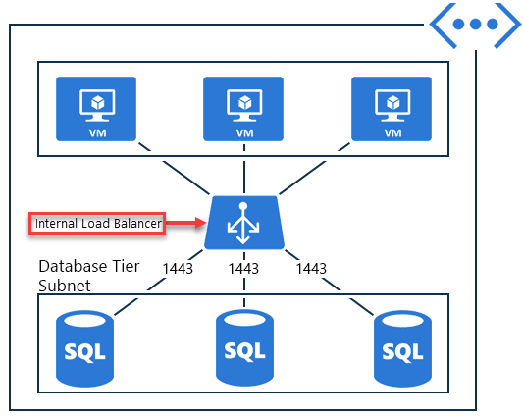
Internal Load Balancer
Directs traffic only to resources inside a virtual network or that use a VPN to access Azure infrastructure.
Frontend IP addresses and virtual networks are never directly exposed to an internet endpoint.
Enables load balancing within a virtual network, for cross-premises virtual networks, for multi-tier applications, and for line-of-business applications.
Notes:
✔ Can you see how a public load balancer could be placed in front of the internal load balancer to create a multi-tier application.

Slide 20
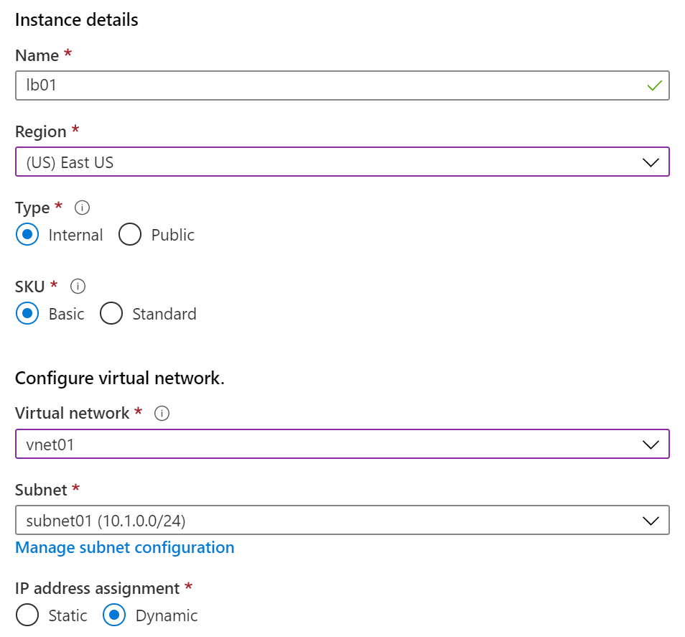
Load Balancer SKUs
Load balancer supports both Basic and Standard (newer) SKUs
SKUs are not mutable
Load Balancer rule cannot span two virtual networks
No charge for the Basic Load Balancer SKU
Load Balancer frontends are not accessible across global virtual network peering

Slide 21
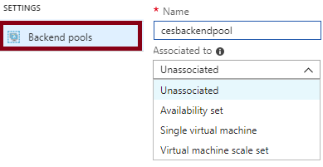
Backend Pools
SKU | Backend pool endpoints
Basic SKU | VMs in a single availability set or VM scale set.
Standard SKU | Any VM in a single virtual network, including a blend of VMs, availability sets, and VM scale sets.
To distribute traffic, a back-end address pool contains the IP addresses of the virtual NICs that are connected to the load balancer
Notes:
✔ In the Standard SKU you can have up to 1000 instances in the backend pool. In the Basic SKU you can have up to 100 instances.

Slide 22
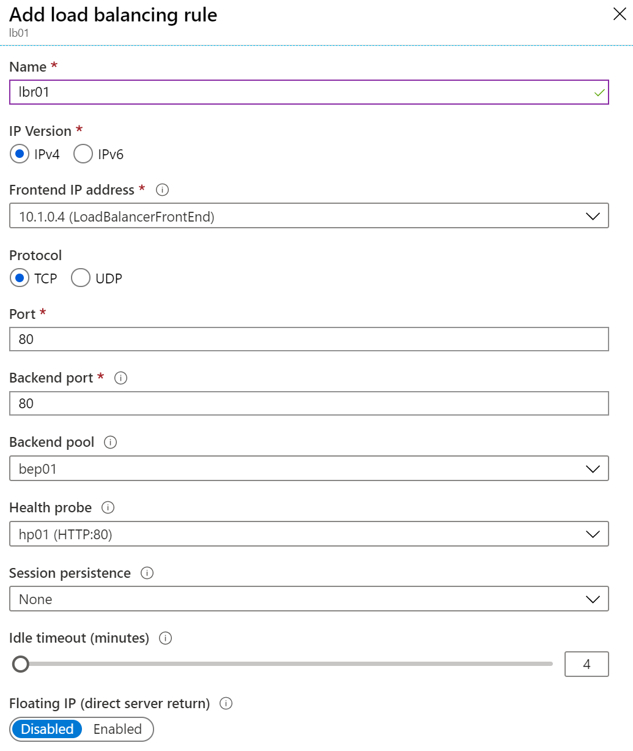
Load Balancer Rules
Maps a frontend IP and port combination to a set of backend IP addresses and port combination
Rules can be used in combination with NAT rules
A NAT rule is explicitly attached to a VM (or network interface) to complete the path to the target
Notes:
✔ Can you see the difference between load balancing rules and NAT rules? Remember, this approach should only be used when you need connectivity from the Internet. Most normal communications would occur from on-premises to Azure connections such as site-to-site VPN and ExpressRoute.

Slide 23
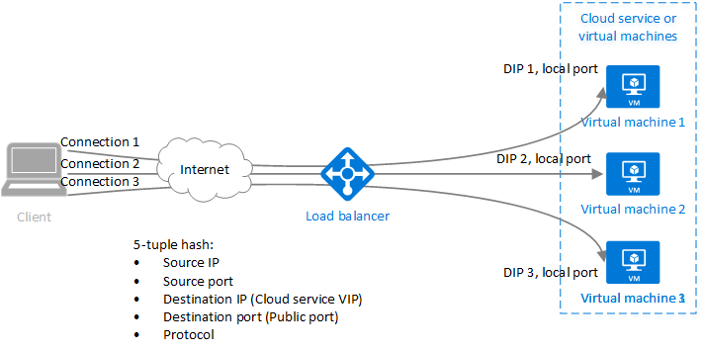
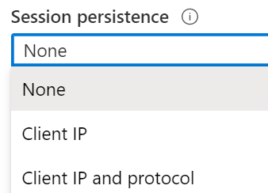
Session Persistence
Session persistence specifies how client traffic is handled
Client IP (default) requests can be handled by any virtual machine
Client IP and protocol specifies that successive requests from the same address and protocol will be handled by the same virtual machine
Notes:
✔Keeping session persistence information is very important in applications that use a shopping cart. Can you think of any other applications?

Slide 24
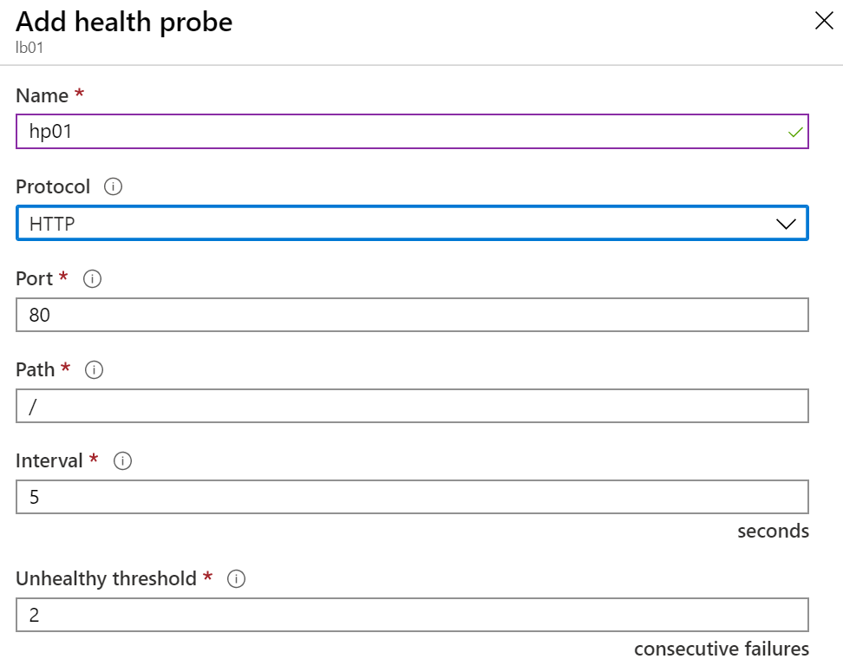
Health Probes
Allows the load balancer to monitor the status of an app
Dynamically adds or removes VMs from the load balancer rotation based on their response to health checks
HTTP custom probe (preferred) pings every 15 seconds
TCP custom probe tries to establish a successful TCP session
Notes:
✔ There is also a guest agent probe. This probe uses the guest agent inside the VM. It is not recommended when HTTP or TCP custom probe configurations are possible. Relate back to the original diagram to ensure all the components are covered.

Slide 25
Lesson 03: Azure Application Gateway

Slide 26
Application Gateway Overview
Application Gateway
Application Gateway Routing
Application Gateway Configuration

Slide 27
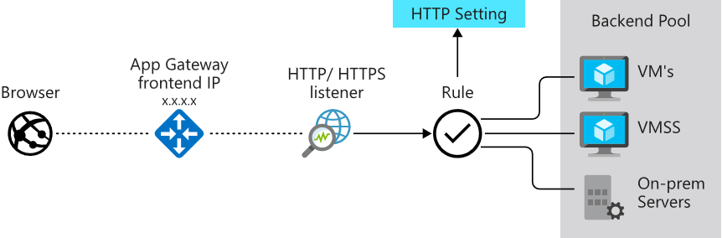
Application Gateway
Manages web app requests
Routes traffic to a pool of web servers based on the URL of a request
The web servers can be Azure virtual machines, Azure virtual machine scale sets, Azure App Service, and even on-premises servers

Slide 28
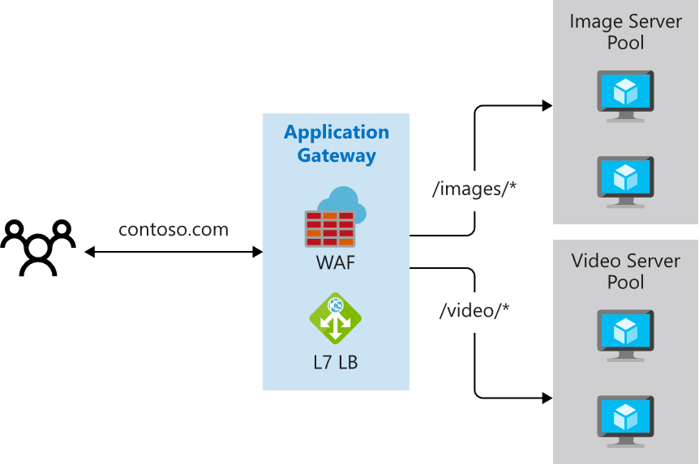
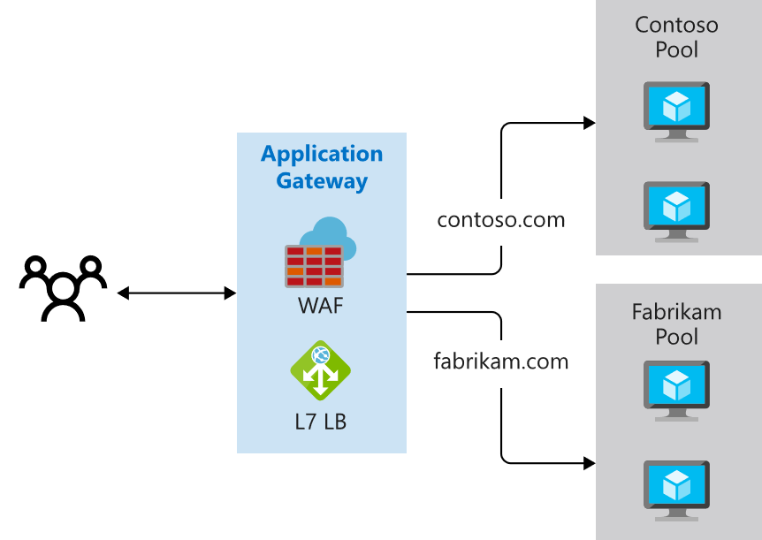
Application Gateway Routing
Path-based routing
Multiple-site routing

Slide 29
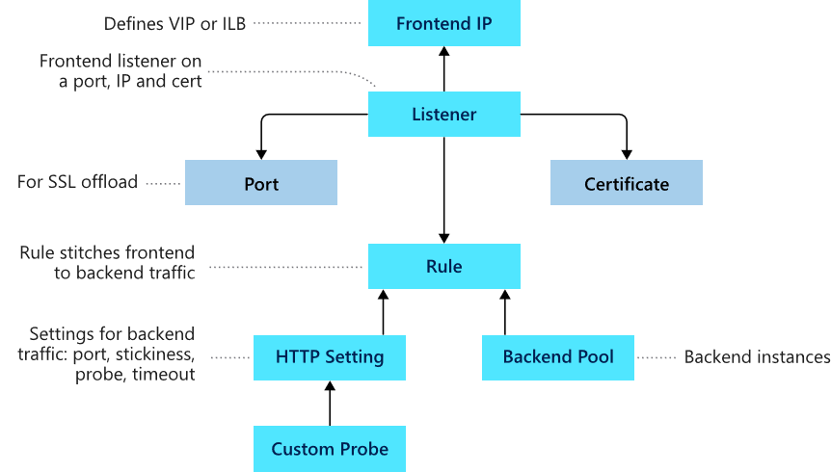
Application Gateway Components
Frontend IP
Listeners
Routing rules
Backend pools
Web application firewall (optional)
Health probes

Slide 30
Lesson 04: Azure Traffic Manager

Slide 31
Traffic Manager Overview
Azure Traffic Manager
Traffic Manager Routing Methods
Distributing Network Traffic

Slide 32
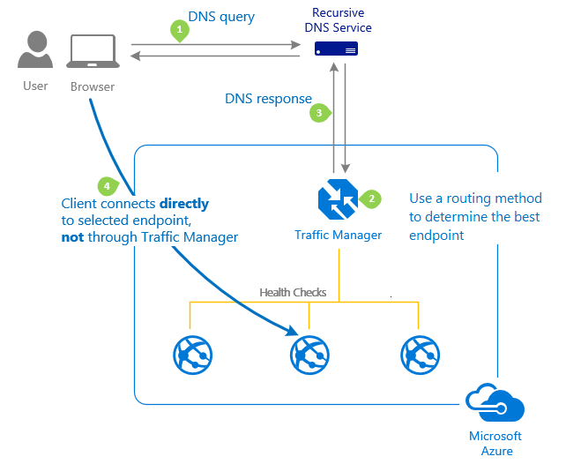
Azure Traffic Manager
Allows you to control distribution of user traffic to service endpoints around the world
Uses DNS to direct end-user requests to the most appropriate endpoint
Selects an endpoint based on the configuring traffic-routing method
Provides endpoint health checks and automatic endpoint failover
Notes:
Traffic Manager - https://azure.microsoft.com/en-us/services/traffic-manager/

Slide 33
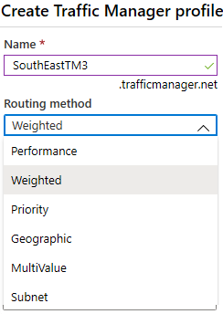
Traffic Manager Routing Methods
Priority routing routes traffic to a prioritized list of service endpoints
Performance routing Routes traffic to the location closest to the user
Geographic routing routes traffic to a set of geographic locations
Weighted routing distributes traffic evenly using a pre-defined weighting
MultiValue routing distributes traffic only to IPv4 and IPv6 endpoints
Subnet routing distributes traffic based on source IP ranges

Slide 34
Distributing Network Traffic
Service | Azure Load Balancer | Application Gateway | Traffic Manager
Technology | Transport Layer (level 4) | Application Layer (level 7) | DNS Resolver
Protocols | Any TCP or UDP Protocol | HTTP, HTTPS, HTTP/2, & WebSockets | DNS Resolution
Backends or Endpoints | Azure Virtual Machines, and Azure Virtual Machine Scale Sets | Azure Virtual Machines, Azure Virtual Machine Scale Sets, Azure App Services, IP Addresses, and Hostnames | Azure Cloud Services, Azure App Services, Azure App Service Slots, and Public IP Addresses
Network Connectivity | External and Internal | External and Internal | External
Azure has several options to distribute network traffic
They can each be used in isolation or in combination

Slide 35
Lesson 05: Module 06 Lab and Review

Slide 36
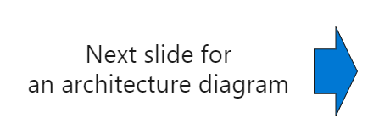
Lab 06 – Implement Traffic Management
Scenario
You are tasked with implementing a hub spoke topology for network traffic. The topology should include an Azure Load Balancer and Azure Application Gateway.
Objectives Task 1: Provision the lab environment Task 2: Configure the hub and spoke network topology Task 3: Test transitivity of virtual network peering Task 4: Configure routing in the hub and spoke topology Task 5: Implement Azure Load Balancer Task 6: Implement Azure Application Gateway

Slide 37
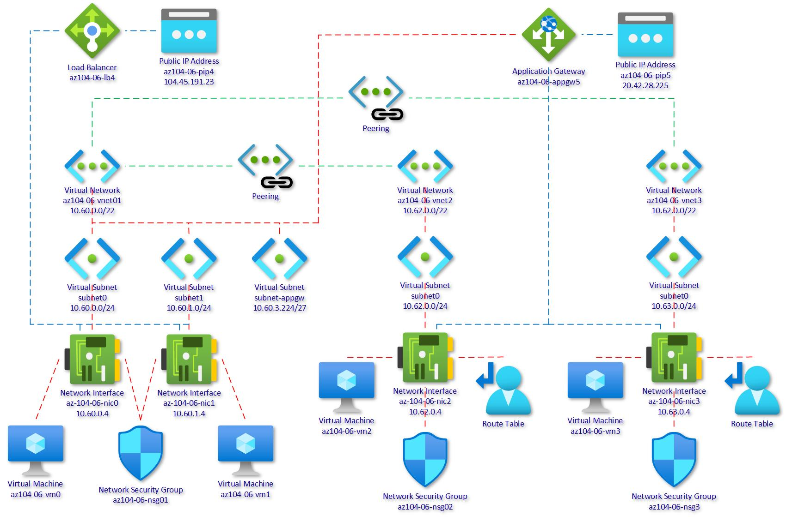
Lab 06 – Architecture Diagram
1
2
3
Notes:
Break down the explanation by reviewing the components in each of the three virtual networks.

Slide 38
Module Review
Module Review Questions
Microsoft Learn Modules (docs.microsoft.com/Learn)
Manage and control traffic flow in your Azure deployment with routes
Improve application scalability and resiliency by using Azure Load Balancer
Load balance your web service traffic with Application Gateway
Enhance your service availability and data locality by using Azure Traffic Manager
Notes:
https://docs.microsoft.com/en-us/learn/modules

